Slide 1
Online Legal Research Outside of Lexis and WestLaw
Oct. 17, 2012
St. Mary’s University Law Library
Wilhelmina Randtke
wrandtke@stmarytx.edu
Notes:
Hello. I’m glad you came with other things going on today during the lunch hour.
I’m Wilhelmina Randtke. I’m the Electronic Services Librarian at the law library. In the past, I’ve worked in employment and administrative law and in web development. Here, I’m the person you contact, if you ever have a problem with getting to an online resource.
If you ever need to contact me, you can find my information here (on the staff directory of the law library website), and you can find my

Slide 2
What’s not in Lexis and WestLaw
Information about your case
Ex: When is my next hearing?
Ex: What is the plaintiff’s current address?
Administrative law
Ex: Tax law
Ex: Federal grant requirements
Ex: Anything with a state agency
International law

Slide 3
Overview
Search engines
Advanced search features
Search engine has gaps in what it indexes
Court dockets
We’ll look at a sample docket
Specialized research databases
Know these exist, and how to find one
Some tools to look across these

Slide 4
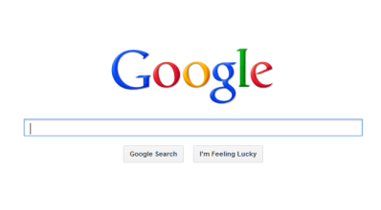
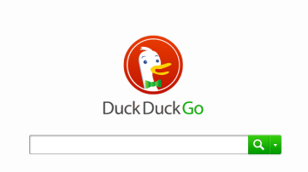
Search engines
Today:
“Advanced Search” features
What they don’t do
They DON’T INDEX EVERYTHING!
Also important:
Learn how search engines work, what they push to the top, and how each personalizes results.
Notes:
Also important
Search engines favor the most popular things; not accurate things
Your search history may be visible
Bing connects with Facebook
Google connects with G+

Slide 5
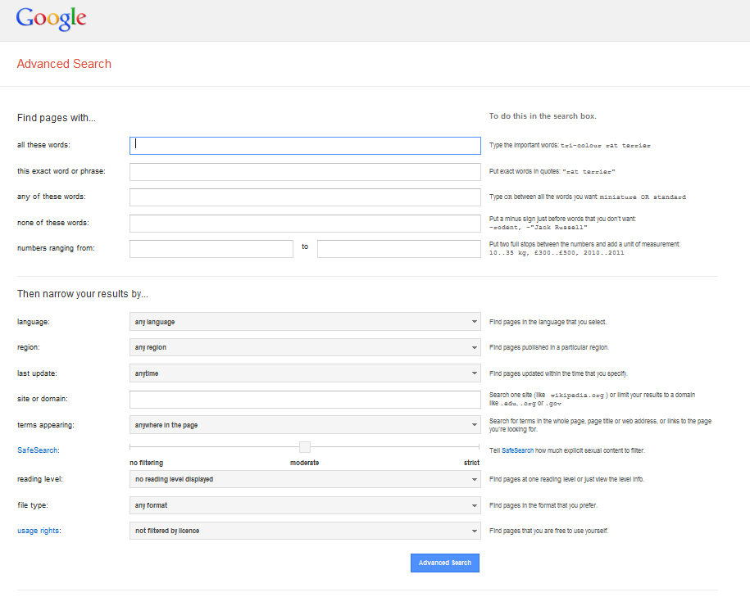
Use the “Advanced Search” screen
Notes:
The advanced search lets you do a lot more.

Slide 6
Use the “Advanced Search” screen
Notes:
The advanced search lets you do a lot more.
Two features to notice for legal research are:
Site search
and
File type search
Site search: You can limit your search results to just a specific website, or folder on a website. This is great for when an agency has a bunch of documents posted, but doesn’t put a search up for you.
File type: This is great for fishing for documents. If you realize that an agency is putting what you want up as PDFs, or as .docs, then you can just get a list of those.

Slide 7
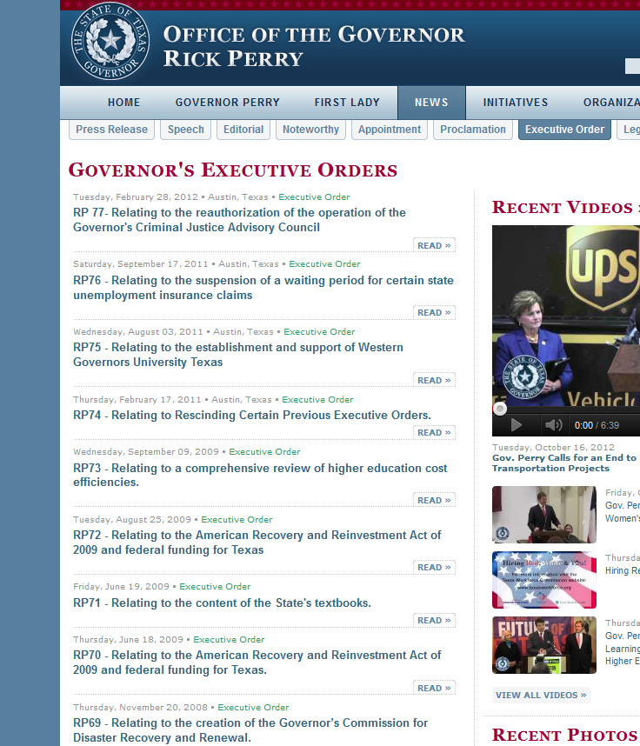
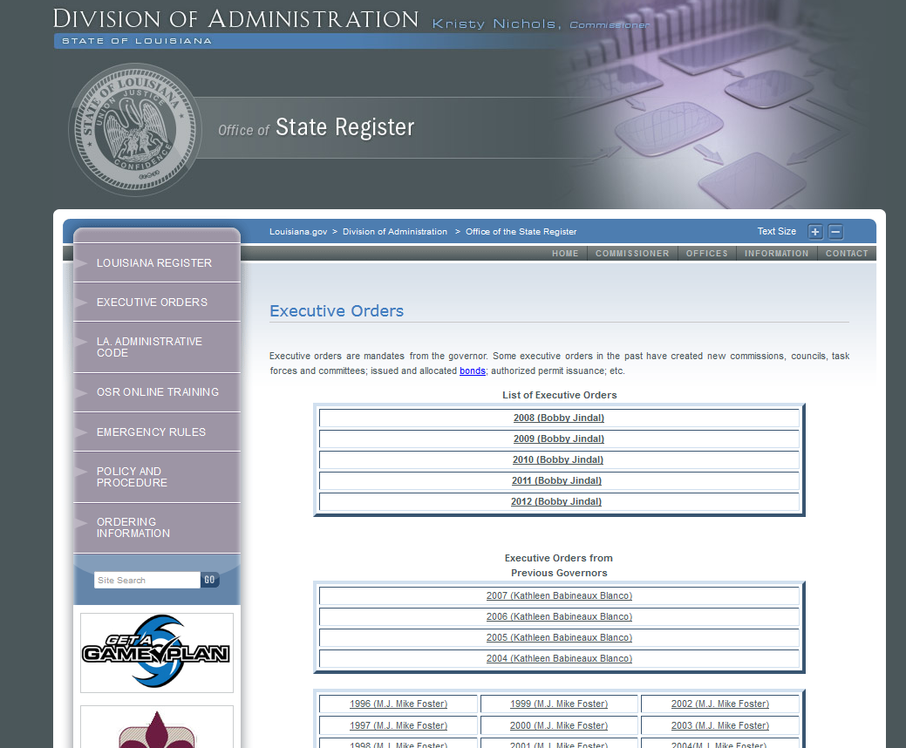
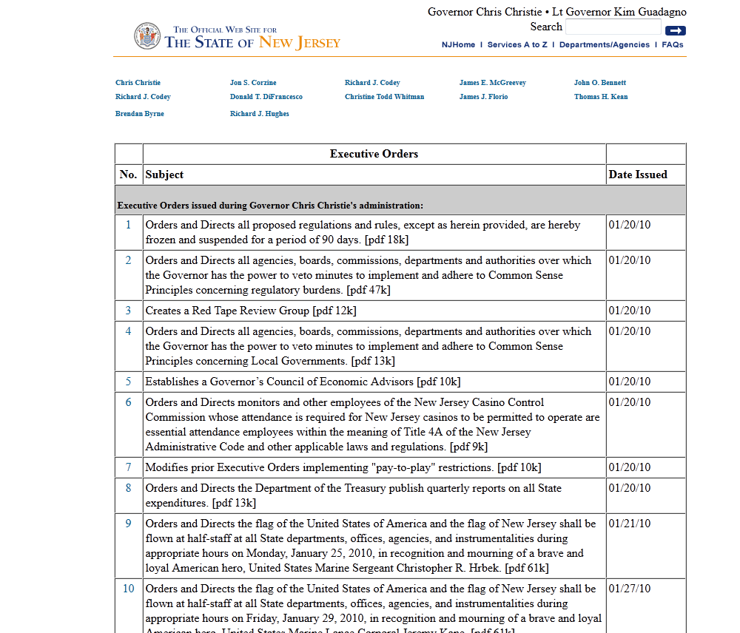
Site search
Use this if an agency has documents up, but doesn’t give you a search.
(but, if an agency gives you a search, then try to use that. It is likely to be more comprehensive.)

Slide 8
Site search Example: Find administrative order mentioned in a news article
Texas Bar Journal article on hydraulic fracturing:
Table of Contents http://www.texasbar.com/AM/Template.cfm?Section=Texas_Bar_Journal&Template=/CM/HTMLDisplay.cfm&ContentID=13949
Article http://www.texasbar.com/AM/Template.cfm?Section=Texas_Bar_Journal&Template=/CM/ContentDisplay.cfm&ContentID=13928

Slide 9
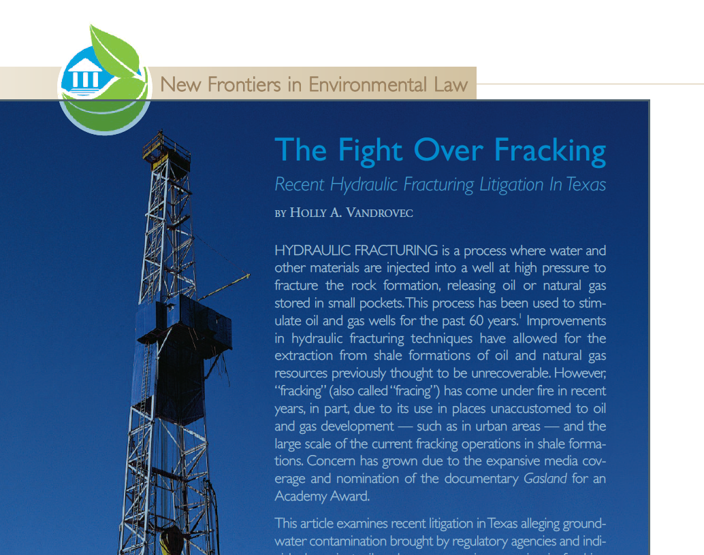

Slide 10
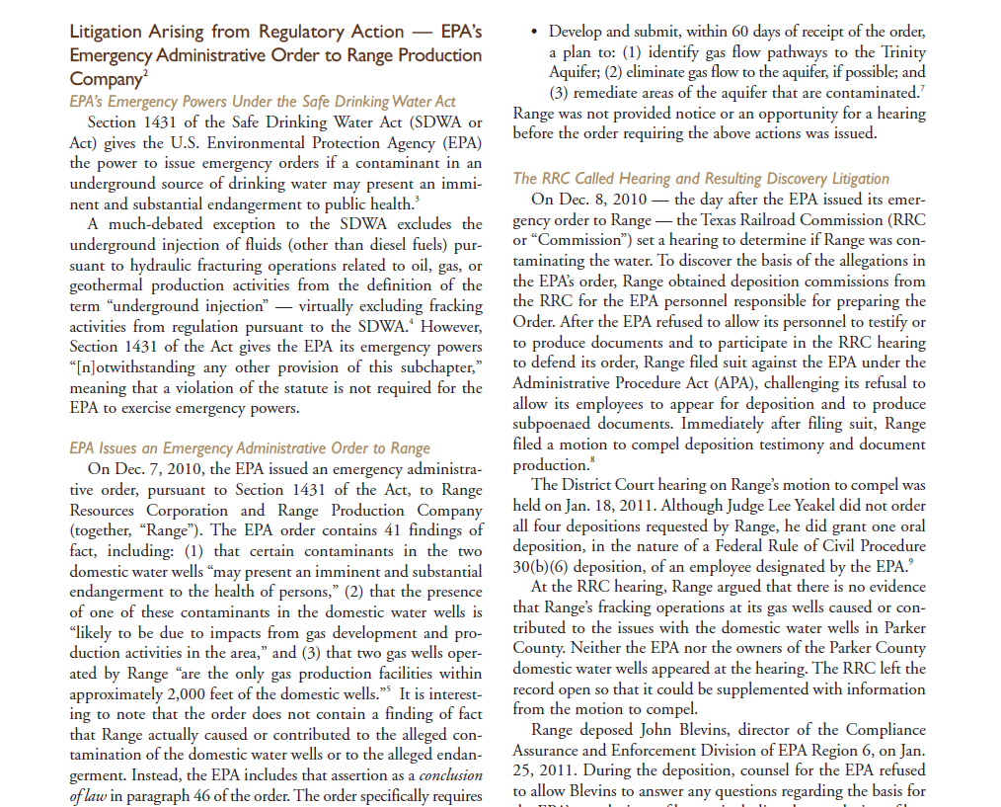
Notes:
I want to find more about this Texas Railroad Commission hearing.
Ellicit: Where do I go?
1st: Check the endnote

Slide 11
Notes:
Check endnote 8

Slide 12
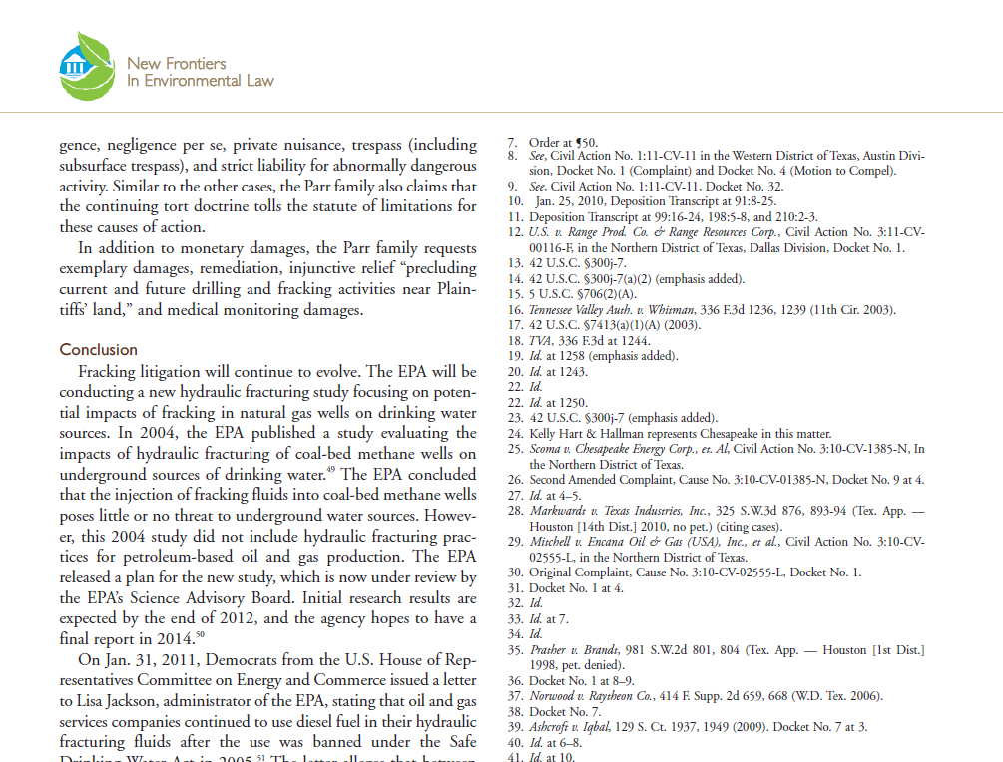
Endnote 8 doesn’t cite the
RailroadCommission’s order.
Notes:
Endnote 8 doesn’t cite the Railroad Commission’s order.

Slide 13
Where can I find more on this hearing?
Notes:
I want to find more about this Texas Railroad Commission hearing.
Ellicit: Where do I go?
Next: Look for the orders on the Railroad Commission’s website.

Slide 14
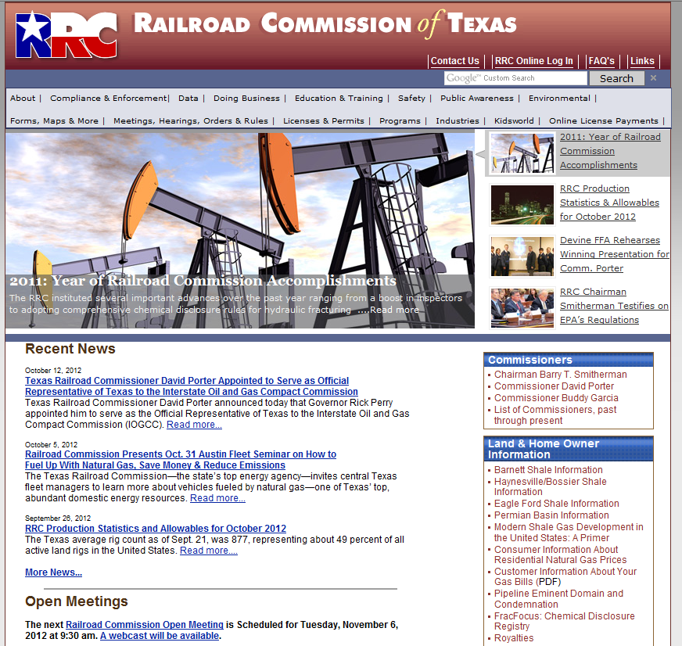

Slide 15
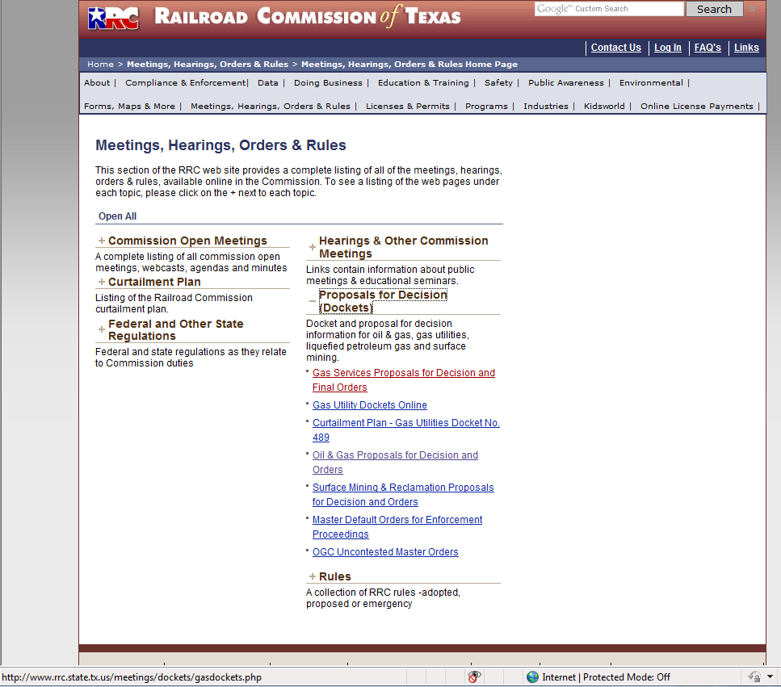
Notes:
I know it’s going to be an administrative order. I click through these.
They are arranged by topic, then by docket number. There is not a search for the orders.

Slide 16
Notes:
I can try the search for the website.

Slide 17
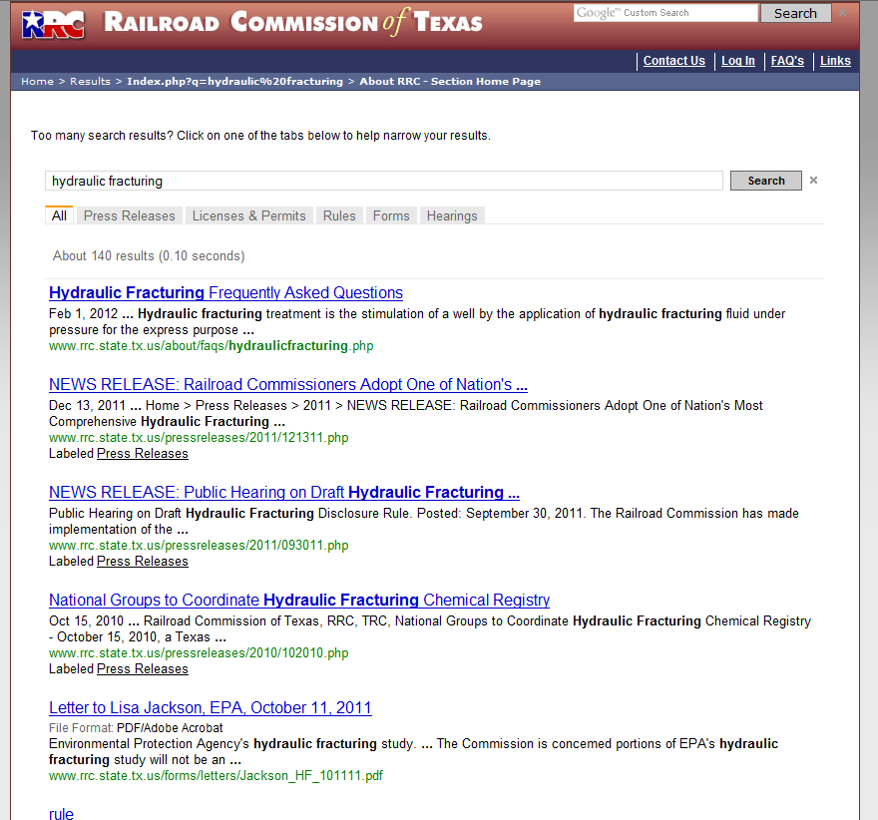
Notes:
Using the agency’s search gets 140 results, and most look to be press releases. I will have to get a lot closer to get to information about the hearing.

Slide 18
Notes:
I have to find a way to search these orders.

Slide 19
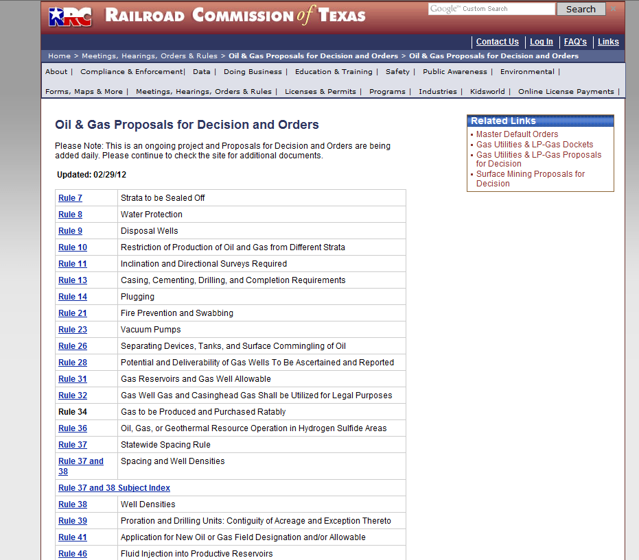

Slide 20
Mouse over links to get a feel for
where things are on the website.
Notes:
Mouse over each possible location for orders.
Most are in the http://www.rrc.state.tx.us/meetings/ogpfd/ folder
All are in the http://www.rrc.state.tx.us/meetings/ folder

Slide 21
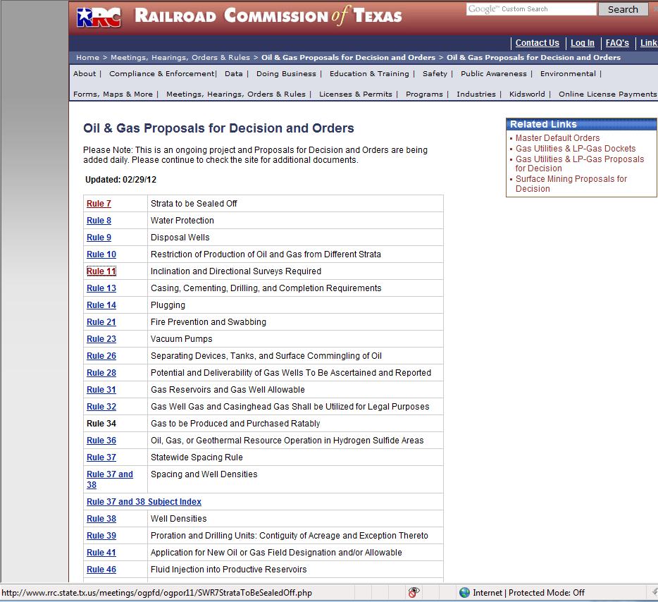
All the orders are in this folder: http://www.rrc.state.tx.us/meetings/ogpfd/
Notes:
All orders are in this folder.

Slide 22
Use the “Advanced Search” screen
Notes:
Use the advanced search

Slide 23
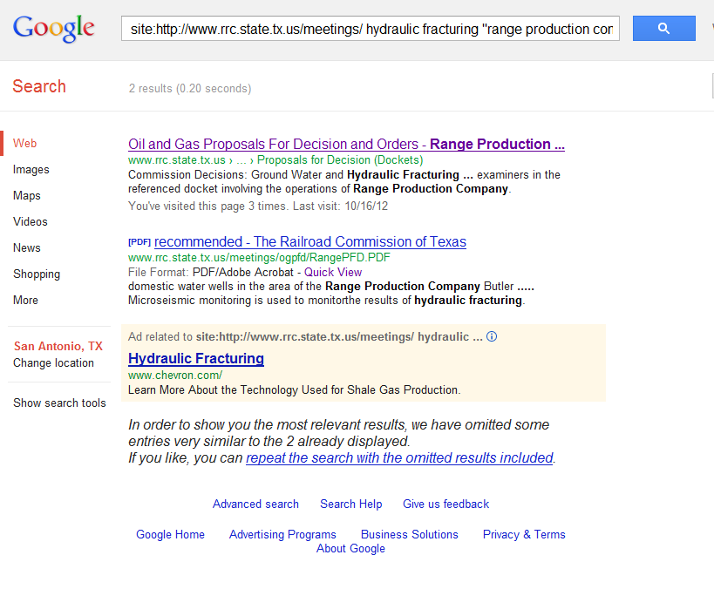
Notes:
I have two hits. The first is the docket (list of all activity in the case) – from this I can get to all documents in the case. The second is a proposed order – it’s 19 pages long and has an explanation of the state law.

Slide 24
Bonus = cache/ “quick view”

Slide 25
Search Engines don’t index everything
Example: Texas Supreme Court Briefs: http://www.supreme.courts.state.tx.us/ebriefs/ebriefs.asp
Notes:
When I go to this site, I can look at how the briefs are arranged.
Go to 2009-05 – lots of briefs
Go to some other cases – briefs
All are in http://www.search.txcourts.gov/
When I Google site search this, I get 199 documents.
I guarantee you, there are more than 199 briefs in there.

Slide 26
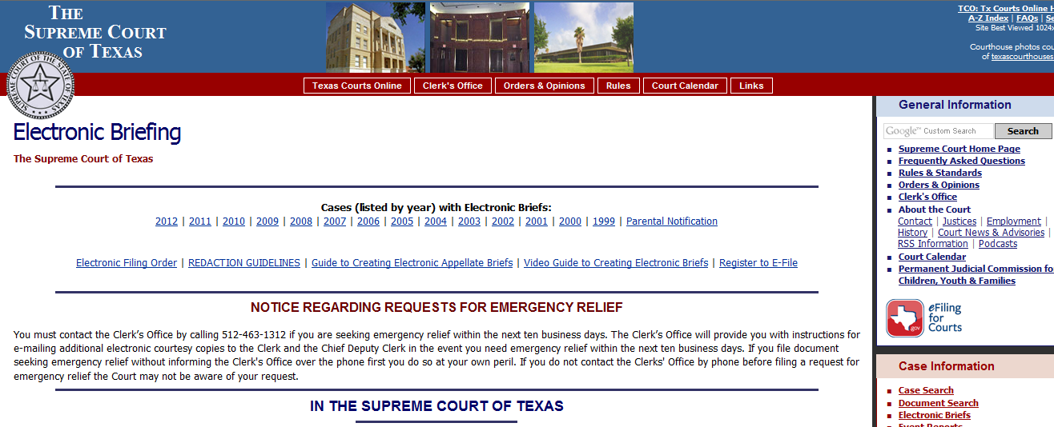

Slide 27
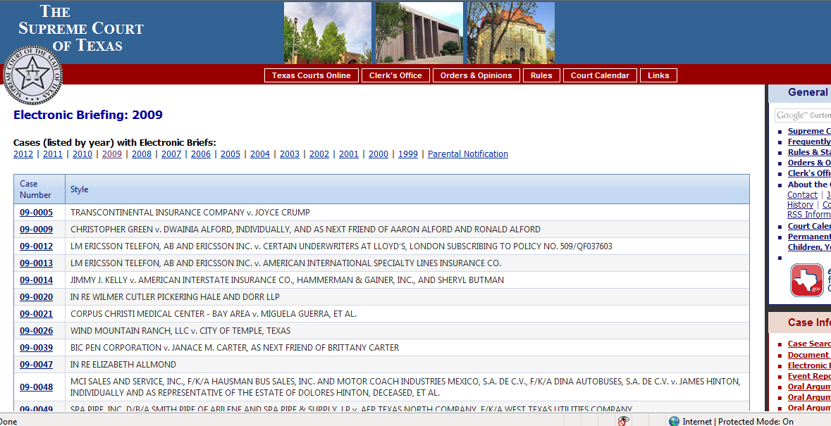

Slide 28
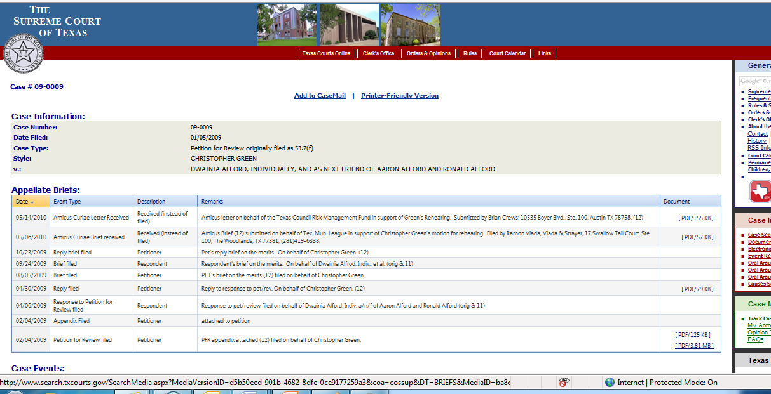

Slide 29
Search Engines don’t index everything
Example: Texas Supreme Court Briefs: http://www.supreme.courts.state.tx.us/ebriefs/ebriefs.asp
The briefs are in http://www.search.txcourts.gov/
A Google site search of http://www.search.txcourts.gov/ finds only 199 documents. → Many missing documents.
Notes:
When I go to this site, I can look at how the briefs are arranged.
Go to 2009-05 – lots of briefs
Go to some other cases – briefs
All are in http://www.search.txcourts.gov/
When I Google site search this, I get 199 documents.
I guarantee you, there are more than 199 briefs in there.

Slide 30
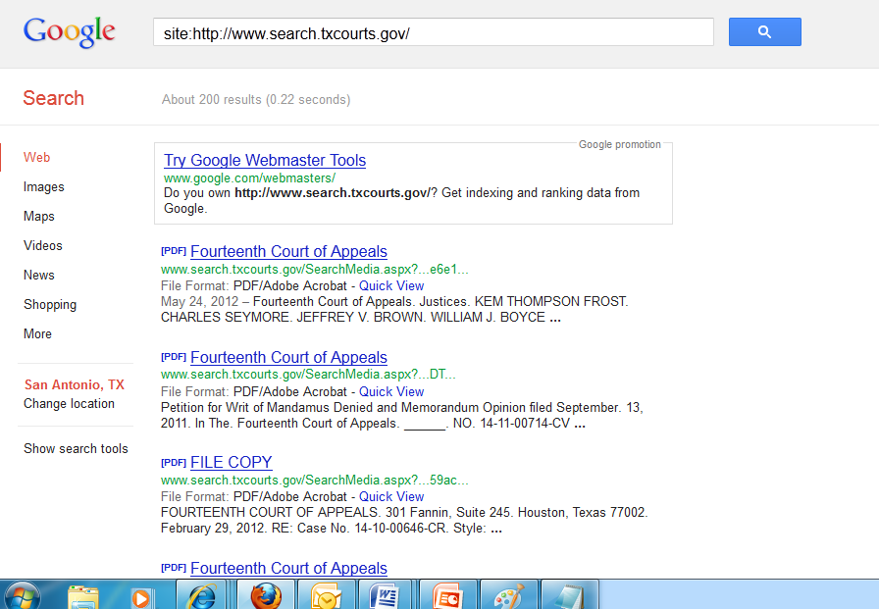
We know that there are many many more briefs. 2 per case, minimum, for every case, over a 5 year period. Surely, the Court hears more than 10 cases per year.

Slide 31
Search Engines don’t index everything
If the agency has its own search box, then use that.
(Many Texas agencies have a Google custom search, so be aware it doesn’t get everything.)
Use multiple search engines
Google, Bing, Yahoo, DuckDuckGo, Blekko

Slide 32
Court Dockets
What is a docket?
Notes:
You tell me. What is a docket?
This is a listing of all the activity in a court case. Everytime a paper is filed, the clerk will write a short – a few words to a sentence – note with the date. All these are logged on the docket.
So, whenever you are in court that’s a map of your case.

Slide 33
Court Dockets
What is a docket?
How do you use the docket?
Notes:
How do you use the docket?
The docket is a map of your case. You DO NOT ever use it to do primary research.
You use it to research your own client, your judge, and whether the opposing lawyer has filed anything yet.
For an active case, you check the docket daily. Especially, if you are waiting for a filing.

Slide 34
Example dockets:
Bexar County Clerk of Court’s website is at: http://gov.bexar.org/dc/
Very limited information
Guadalupe County Clerk of Court’s website is at: http://www.co.guadalupe.tx.us/guadalupe2010/home.php?content=ccl
No online docket at all
(Guadalupe has a population of about 135,000 , and does not have dockets online.)
Harris County Clerk of Court’s website is at: http://www.cclerk.hctx.net/
Full docket is online
Medina County Clerk of Court’s website is at: http://www.co.medina.oh.us/medct_epublicnodr/

Slide 35
Example docket for a case:
Medina County: http://www.co.medina.oh.us/medct_epublicnodr/
Example search : John Smith
Docket has
Every piece of paper filed in the case
Dates and times of hearings – posted before the hearing happens
Notes:
John Smith’s case versus Atlas America (04CIV1263 ) has lots of activity, and is good for demoing the docket.

Slide 36
Court dockets
All are different.
Before you do anything in a case, always check the docket.
When a client walks in the door, check the docket.

Slide 37
Specialized Research Databases
Need to know that these exist; Find them when you need them.
Get familiar with tools to look across databases.
(These help you find a database.)
eJournal locator
Worldcat.org
Library catalog

Slide 38
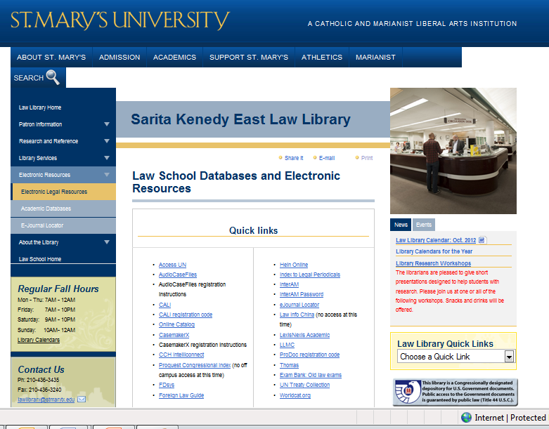
St. Mary’s law: specialized research databases
Notes:
Lots of databases, you can look at the quicklinks for a list.
Lots of databases.

Slide 39
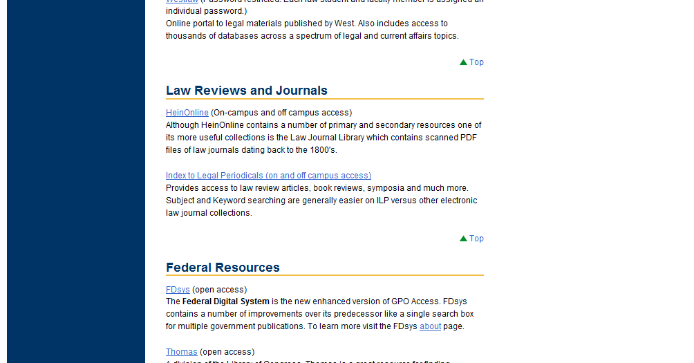
St. Mary’s law: specialized research databases
Notes:
Scroll down, and you can see a description. There are only 19 of them. If you print this page out, with the description, it’s less than 5 pages. Who had to read more than 5 pages last night?
These descriptions aren’t great. Don’t memorize it, or take it too seriously. At the same time, the descriptions have the buzz words. HeinOnline has journals, and it says “journals” in the description.

Slide 40
St. Mary’s law: specialized research databases
(First, a little bit about access.)
Notes:
Scroll down, and you can see a description. There are only 19 of them. If you print this page out, with the description, it’s less than 5 pages. Who had to read more than 5 pages last night?
These descriptions aren’t great. Don’t memorize it, or take it too seriously. At the same time, the descriptions have the buzz words. HeinOnline has journals, and it says “journals” in the description.

Slide 41
Access
Anyone physically in the library can use these.
An employer is very unlikely to provide all of these (but may provide some, if they are related to the practice area).
Other databases
exist
Ex: Accurint
You will have
access to some-
thing that isn’t
here.
(First, a little bit about access.)
Notes:
Access is important.
Right now, you have more electronic legal research tools than you are likely to have at any point in the future. You have both Lexis and Westlaw. That’s pretty unusual. Then you have this long list of resources. That’s pretty unusual.
When you graduate and are practicing, two things may happen.
You may be employed as a lawyer with a firm or with government. They will give you a WestLaw or a Lexis account. Probably, not both. And you probably won’t get to choose.
Or
You will be practicing as a solo practicioner or with a small firm. If so, then trips here or to another law library may be routine. You’ll see lawyers in here sometimes, using the books, because we have more than almost any firm.
So, either you are going to loose these databases forever, or you are going to use them more, because they will give you the ability to:
Sheparize with Lexis Academic
Pull and email yourself a law review article you need

Slide 42
Specialized Research Databases
Need to know that these exist; Find them when you need them.
Get familiar with tools to look across databases.
(These help you find a database.)
eJournal locator
Worldcat.org
Library catalog

Slide 43
Specialized Database:
#1 Know these exist. When you begin in a new area of law, check whether there is a specialized database you should be using.

Slide 44
Is there a specialty database?
Look for a “research guide” for your area of law
Zimmerman’s guides are good.
Can use a search engine to check on the .edu domains.
Ask around
You will have access to a form bank. Find it.
Revisit this after you have practiced in the area for a while.
Notes:
Look for research guides

Slide 45
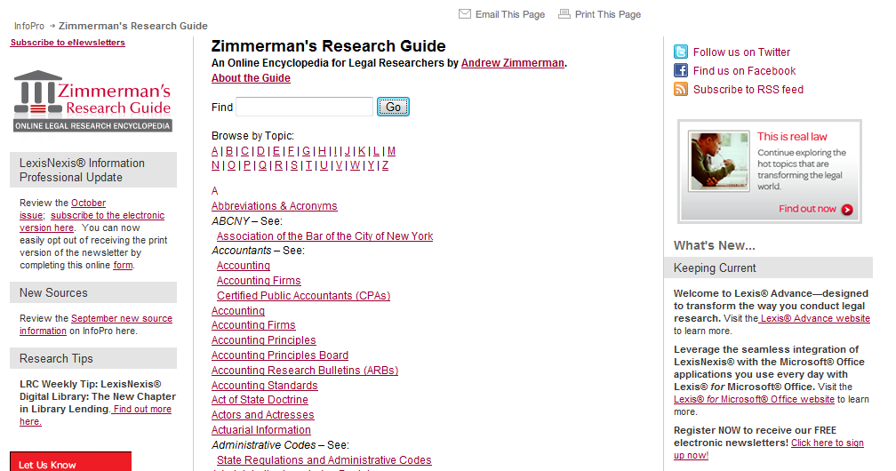
Zimmerman’s Guides
A good quality place to start.
Notes:
Zimmerman’s Guides is a good place to start when you are researching an unfamiliar area of law.
These are hosted by LexisNexis, but LexisNexis does not write them. These are written by Andy Zimmerman, and if you send an email, he will write you back. They have links to resources in Lexis, in WestLaw, and anywhere else that’s relevant.
It’s not a portal to Lexis. It’s a portal to everything (US law related).

Slide 46
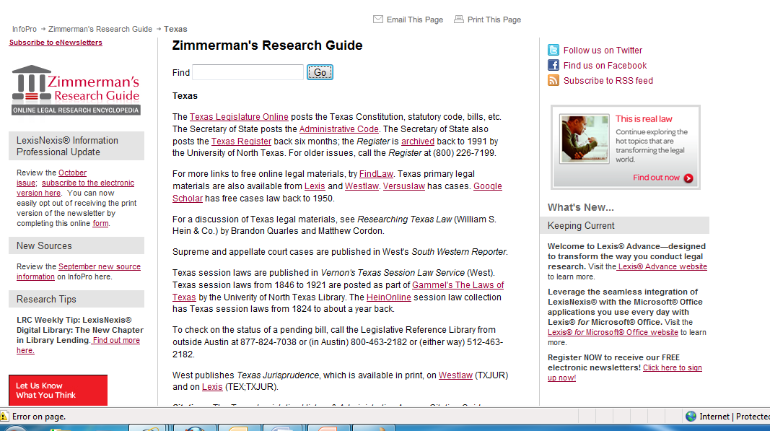
Notes:
And here’s the guide for Texas.

Slide 47
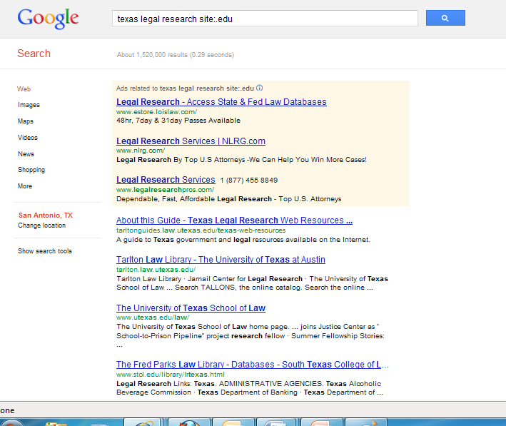
Ways to find more guides

Slide 48
Specialized research databases
#2 Learn to use tools that look across databases
Online catalog
eJournal Locator
Worldcat.org

Slide 49
Tools for looking across databases
Notes:
These are the three tools you absolutely should learn to use.

Slide 50
eJournal Locator
= Go from any journal cite, and find where that resource is located.

Slide 51
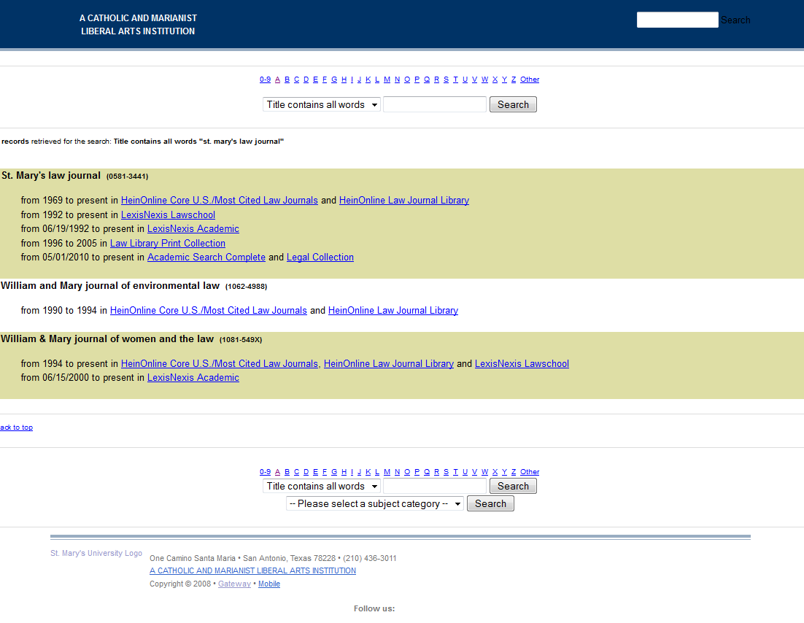

Slide 52
St. Mary’s Online Catalog
= Find the book you want AND all the books about that topic

Slide 53
Two ways to use the catalog
Find a specific book you know exists
Find books about a topic

Slide 54
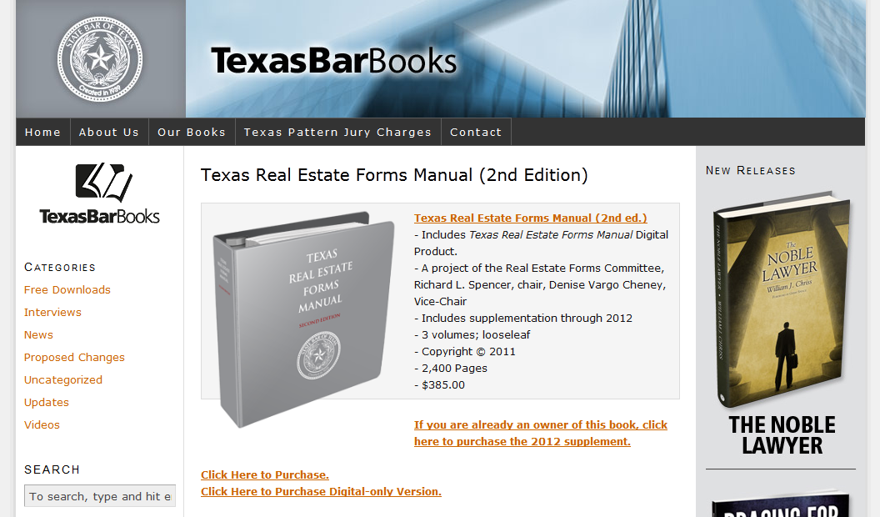
Find a specific book

Slide 55
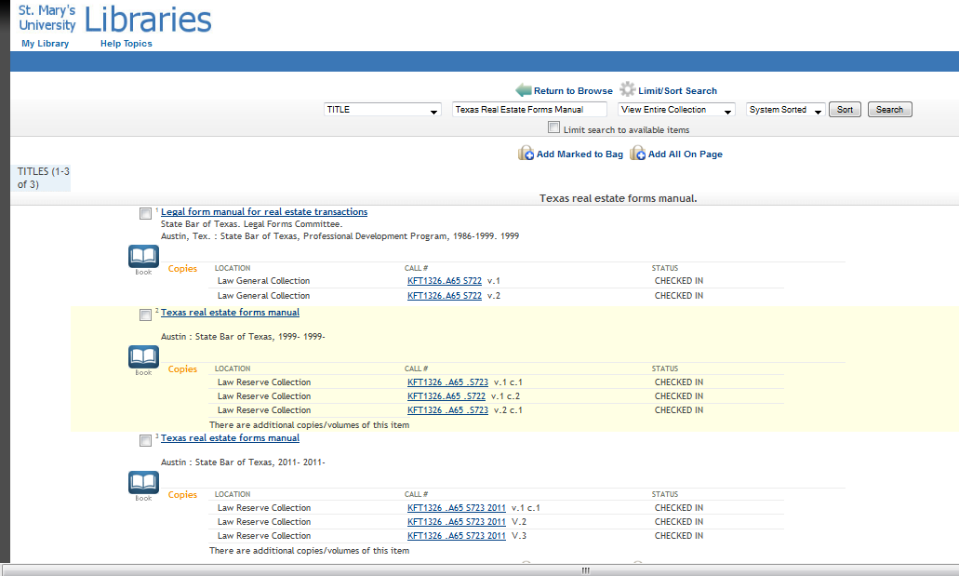

Slide 56
Find books about a topic
Find one book, then use the subject heading.
Example:
Immigration law
www.regina.stmarytx.edu

Slide 57
Worldcat.org
= Search all the library catalogs in the world at once

Slide 58
Worldcat.org
Find all libraries that have the book
All libraries in the world
Sorted by which one is closest to you
Find all the electronic versions, and which databases they are in

Slide 59
Overview
Search engines
Advanced search features
Search engine has gaps in what it indexes
Court dockets
We’ll look at a sample docket
Specialized research databases
Know these exist, and how to find one
Some tools to look across these

Slide 60
Online Legal Research Outside of Lexis and WestLaw
Oct. 17, 2012
St. Mary’s University Law Library
Wilhelmina Randtke
wrandtke@stmarytx.edu
Notes:
Hello. I’m glad you came with other things going on today during the lunch hour.
I’m Wilhelmina Randtke. I’m the Electronic Services Librarian at the law library. In the past, I’ve worked in employment and administrative law and in web development. Here, I’m the person you contact, if you ever have a problem with getting to an online resource.
If you ever need to contact me, you can find my information here (on the staff directory of the law library website), and you can find my

