Slide 1
Researching Immigration Law
October 9, 2013
Presented by Wilhelmina Randtke
Electronic Services Librarian
Sarita Kenedy East Law Library
St. Mary’s University School of Law

Slide 2
Overview: Researching Immigration Law
Major laws
The Immigration and Nationality Act of 1952, as amended
The Immigration Reform and Control Act of 1986
Illegal Immigration Reform and Immigration Responsibility Act of 1996
Codified in US Code and CFR
Title 8 (Aliens and Nationality)
Title 22 (Foreign Relations)
Notes:
Show book as visual The Immigration Law Sourcebook.

Slide 3
Overview: Researching Immigration Law
Administrative courts
DOJ Board of Immigration Appeals (BIA)
USCIS Administrative Appeals Office (AAO)
Administrative Guidance
USCIS Memoranda
USCIS Adjudicator’s Field Manual
US Customs and Border Protection Inspector’s Field Manual
US Department of State Foreign Affairs Manual
Notes:
These are the two terminal courts. Both result in decisions that can be appealed to federal court.

Slide 4
The flavor of immigration law
Notes:
Photo is Creative Commons Attribution CC-BY taken by angela n . http://www.flickr.com/photos/aon/3923084758/sizes/l/in/photostream/

Slide 5
Laws and Regulations: The flavor of immigration law
Major laws
The Immigration and Nationality Act of 1952, as amended
The Immigration Reform and Control Act of 1986
Illegal Immigration Reform and Immigration Responsibility Act of 1996
Enforcement and Administration
Department of Homeland Security formed in 2002
U.S. Citizenship and Immigration Services formed in 2003
U.S. Immigration and Customs Enforcement formed in 2003
Notice anything about the laws and agencies?
Notes:
Each law is codified into the US Code.
So, Section 106 of the INA will be at 8 USC something.
Title 8 of the US Code generally corresponds to title 8 of the CFR.
You probably have enough training in researching statutes and regulations, that you won’t need much on this.
Use a treatise to get to federal law or regulation, then pull up the law or regulation, then Sheppardize or KeyCite. Know that Westlaw and Lexis both have just a tiny fraction of the administrative material that exists.
Now, does anyone notice anything about these laws and the agencies that administer the laws?

Slide 6
Laws and Regulations: The flavor of immigration law
Major laws
The Immigration and Nationality Act of 1952, as amended
The Immigration Reform and Control Act of 1986
Illegal Immigration Reform and Immigration Responsibility Act of 1996
Enforcement and Administration
Department of Homeland Security formed in 2002
U.S. Citizenship and Immigration Services formed in 2003
U.S. Immigration and Customs Enforcement formed in 2003
Notice anything about the laws and agencies?
Notes:
The last major revision of immigration law was in 1996. But, the entire government structure that administers the law was redone in 2002, with the Department of Homeland Security.
: One thing to notice is that all the enforcement agencies were formed after the major laws were passed. Previously, all the activities done by DHS, USCIS, and ICE were done by the INS, which was under the Attorney General (ie. under the Department of Justice). So, if you see a law or regulation on the books that refers to the structure under the INS, then you can trust it for the what, but you have to figure out the who. Written law is usually accurate for what the process is, what substantive rights someone with a certain status has. Written law often refers to INS structures that no longer exist.
This is huge in immigration law.
If you are researching, and Title 8 disagrees with Google, then you may be dealing with something that was transferred to a different agency. Search the Homeland Security Act of 2002 to see what was transferred where. Also search the field manuals and administrative guidance for the agency to see if those say a function was transferred.

Slide 7
INS to DHS
Know that USC and CFR will refer to defunct federal structures.
Check the Homeland Security Act of 2002 for transferred functions.
Functions were transferred elsewhere, too. An old INS function might not be in DHS.
Who? What?
???
!!!
Notes:
Don’t try to memorize what transferred where. Just know that it’s an issue. If Google and Title 8 don’t line up as far as what agency is doing something, then check whether that something was transferred to a new agency.

Slide 8
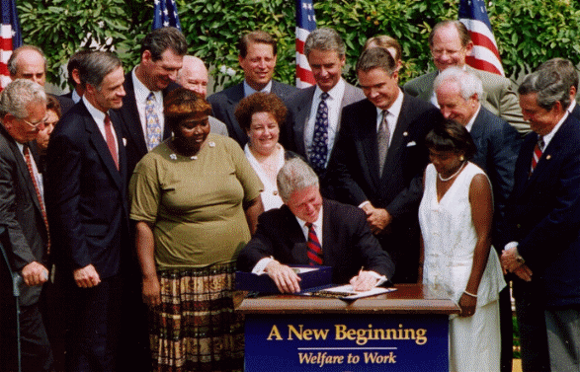
The flavor of immigration law: Overlapping areas of law
They're taking our jobs...
... collecting welfare...
Notes:
This is not that big in immigration law, but it does go to the flavor of immigration law.
As you research, you will see some overlap with employment law and with eligibility for public benefits.
These are the motivations for changes to immigration law, and the big amendments to immigration accompany big amendments to employment or public benefits laws.
employment law
Immigration status includes work restrictions or authorizations. That is how immigration law touches employment law and that is in Title 8. But, also, employment law touches immigration law.
In the North, unions are a much bigger force than in the south. Often the state level department of labor will regularly do on site inspections of employers to make sure they are following their contracts with unions - so, make sure they are only hiring union members, etc. Because the state level department of labor is already doing inspections, the state level department of labor
welfare and public benefits
The Illegal Immigration Reform and Immigration Responsibility Act of 1996, which is the most recent major revision, was part of welfare reform. The major welfare reform law was the Personal Responsibility and Work Opportunity Act of 1996 (PRWORA). This completely restructured welfare. The 1996 immigration law changes were entirely directed at welfare reform. "They're stealing our jobs. Coming here for benefits." Immigration law and public benefits were overhauled together.

Slide 9
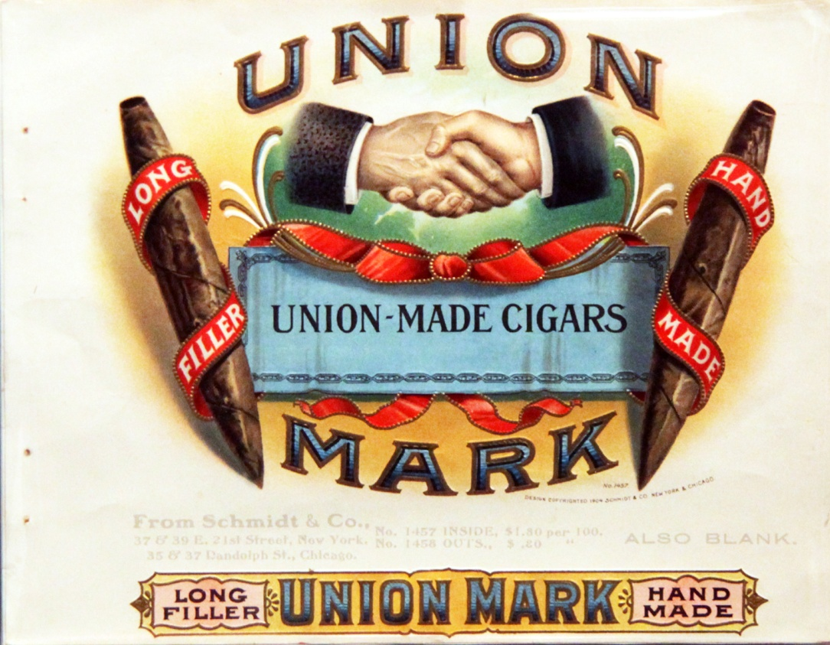
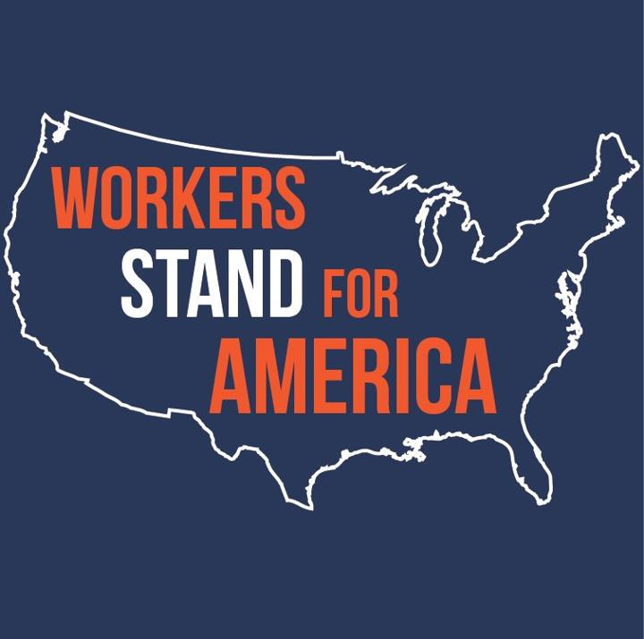
Notes:
employment law
Immigration status includes work restrictions or authorizations. That is how immigration law touches employment law and that is in Title 8. But, also, employment law touches immigration law.
In the North, unions are a much bigger force than in the south. Often the state level department of labor will regularly do on site inspections of employers to make sure they are following their contracts with unions - so, make sure they are only hiring union members, etc. Because the state level department of labor is already doing inspections, the state level department of labor

Slide 10
Two big changes in 1996:
Illegal Immigration Reform and Immigration Responsibility Act of 1996
Personal Responsibility and Work Opportunity Act of 1996 (PRWORA)
Notes:
Big revision in immi
welfare and public benefits
The Illegal Immigration Reform and Immigration Responsibility Act of 1996, which is the most recent major revision, was part of welfare reform. The major welfare reform law was the Personal Responsibility and Work Opportunity Act of 1996 (PRWORA). This completely restructured welfare. The 1996 immigration law changes were entirely directed at welfare reform. "They're stealing our jobs. Coming here for benefits." Immigration law and public benefits were overhauled together.
gration law went along with welfare reform.

Slide 11
Research Framework
Start broad, move to details.
Understand the question asked.

Slide 12
Research framework
Use secondary sources to find primary sources.
Secondary source = books, law review articles, CLEs, practice manuals, advocacy groups
Primary source = binding law, precedent
Use primary sources to nail down the law
Binding vs Persuasive
Binding authority is better.
Make sure you look in the same jurisdiction.
Notes:
When you first come across an issue, this is the same for any area of law. Try to find a summary, then use that summary to find the law.
Show books.
A Guide to Immigration Law http://regina.stmarytx.edu/record=b1625971~S3 – provided at clinic, and also one of the books we will direct you to, if you come to the library desk. Once you practice in an area of law, you will get the feeling for what the best treatise is.
Immigration Law 101 CLE – CLE is continuing legal education. Lawyers are required to take a certain number of these courses each year to keep their bar license. A CLE is usually a presentation that lasts about an hour, or a full day workshop. A CLE can be an introduction to an area of law or a deep dive into law.
Catalog search book, limit to law library, sort by date, and find CLEs.
Also you can get CLEs free of charge from the State Bar of Texas. Show website “Research Guide” with instructions on getting to CLEs. There is a charge for lawyers and members of the public, but no charge for law students.
When you come across a new area of law, try to find what is the “go to” book in that area of law. A good book with an overview of the area of law is essential as a starting place. You can find this by asking other lawyers who have practiced in that area, or by asking at the law library reference desk.
Primary sources.
Binding authority is statutes and case law that your court, you are in front of, must accept and follow. Persuasive authority is usually case law from another jurisdiction. The court you are in front of can choose to follow it or not.

Slide 13
Research framework
Use secondary sources to find primary sources.
Secondary source = books, law review articles, CLEs, practice manuals, advocacy groups
Primary source = law, precedent
Use primary sources to nail down the law
Binding vs Persuasive
Binding authority is better.
Make sure you look in the same jurisdiction.

Slide 14
Laws and Regulations
When researching laws and regulations, make sure the law applies to your situation. Always check the definitions.
Notes:
Always check the definitions, and review cross cites. For example, if you see the term immigrant, you better not assume that you know what it means. The distinction between immigrant and nonimmigrant status is huge, and the definitions tells you what those are.

Slide 15
Binding vs Persuasive
What court are you in front of?
Where would an appeal go?
Board of Immigration Appeals?
Administration Appeals Office?
Federal district court (in which circuit)?
When searching case law, check coverage for the database you are looking in.
Westlaw and Westlaw Next: Lower case i in a circle
Lexis Nexis: Lower case i in a box
Lexis Advance: Browse sources, click name of source, “View all information about this source”
Notes:
Check coverage
Westlaw and Westlaw Next: Lower case i in a circle
Lexis Nexis: Lower case i in a box
Lexis Advance: Browse sources, click name of source, “View all information about this source”
If your court is not in that coverage, then you need to find out where it is.

Slide 16
Case law for immigration
Cases start in an administrative system, then can appeal through administrative system up to federal court.
Federal courts review administrative decisions. Federal court decisions are binding on that circuit, persuasive on other circuits.
Administrative Courts
Notes:
The key thing to understand is that immigration cases start in an administrative system. Each level of court you are in, only a fraction of cases will appeal up. Much more case law is available in the administrative system than in federal court decisions. And, federal courts get a huge amount of cases that have nothing to do with immigration.
A targeted search will look at both the federal decisions and the administrative decisions.

Slide 17
Case law for immigration
Administrative courts:
USCIS Administrative Appeals Office (AAO)
DOJ Board of Immigration Appeals (BIA)

Slide 18
USCIS Administrative Appeals Office (AAO)
Progress of a case:
Petition is filed with USCIS regional service center or district office. Decision is made.
Can appeal decision to USCIS AAO.
Can appeal that decision to federal court.
Where to find AAO decisions:
Lexis Advance (Browse Sources → search AAO)
Lexis Nexis (Find a Source → search AAO)
WestLaw (Search for a database → FIM-BIA)
WestLaw Next (Browse → All Content (tab) → click Administrative Decisions and Guidance → Administrative Appeals Unit Decisions)
EOIR Virtual Law Library (http://www.justice.gov/eoir/vll/intdec/lib_indecitnet.html )
Notes:
EOIR library AAO decisions are at the bottom of the page

Slide 19
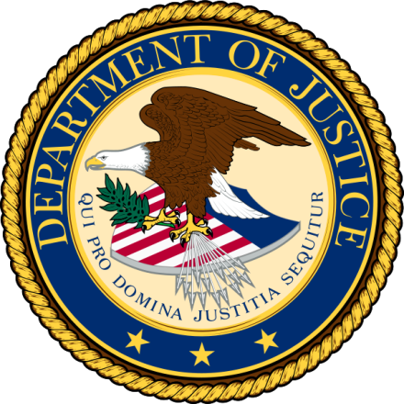
DOJ Board of Immigration Appeals (BIA)
U.S. Department of Justice
is over
Executive Office for Immigration Review
is over
Board of Immigration Appeals

Slide 20
DOJ Board of Immigration Appeals (BIA)
Progress of a case:
Immigration Judge in the Department of Justice makes a decision.
This can be appealed to the BIA.
This can be appealed to federal court.
Where to find BIA decisions:
Lexis Advance (Browse Sources → search BIA)
Lexis Nexis (Find a Source → search BIA)
WestLaw (Search for a database → FIM-BIA)
WestLaw Next (Browse → All Content (tab) → click Administrative Decisions and Guidance → Board of Immigration Appeals Decisions)
EOIR Virtual Law Library (http://www.justice.gov/eoir/vll/intdec/lib_indecitnet.html )
Notes:
Westlaw and Lexis are back to 1940.
EOIR Virtual Law Library is back to 1955.

Slide 21
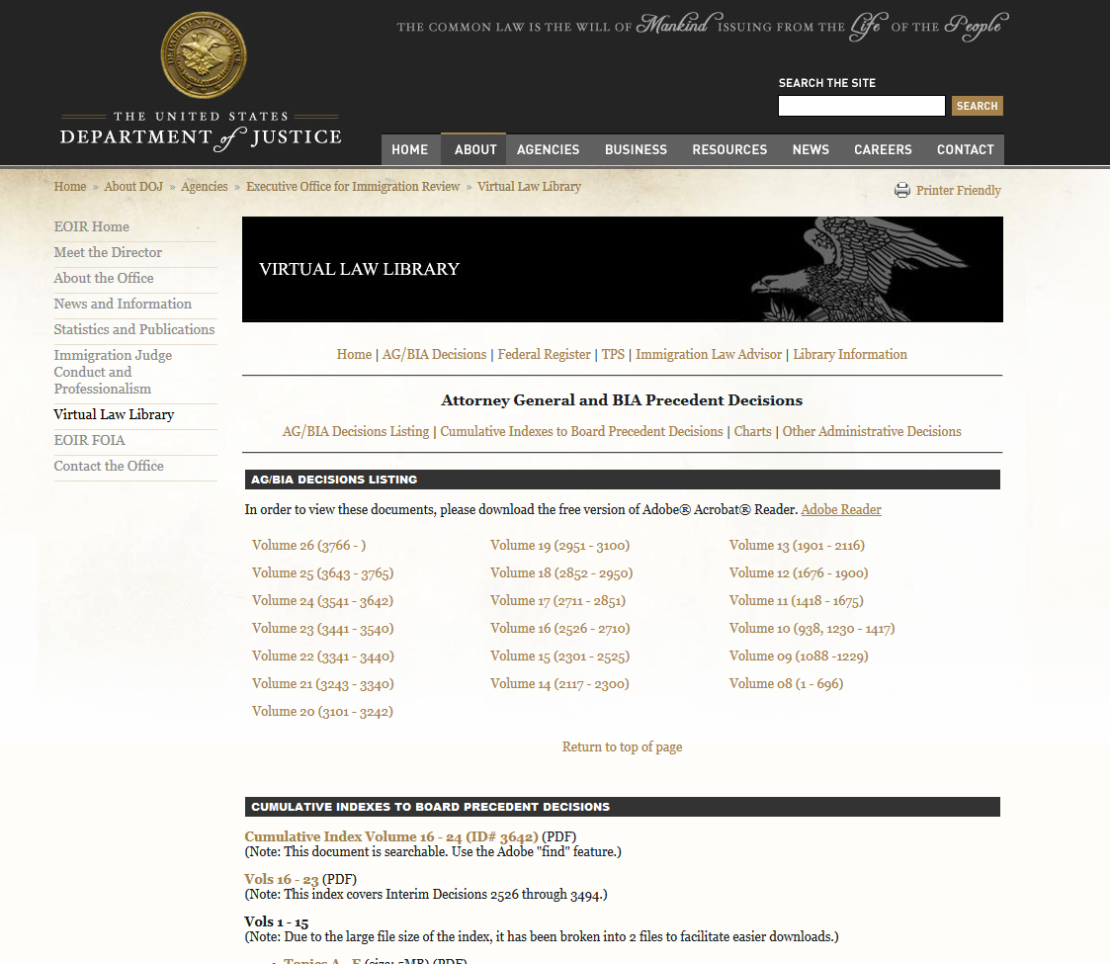
EOIR Virtual Law Library

Slide 22
Agency materials
Memos, field manuals, guidance
Field manuals
USCIS Adjudicator’s Field Manual
US Customs and Border Protection Inspector’s Field Manual
US Dept. of State Foreign Affairs Manual

Slide 23
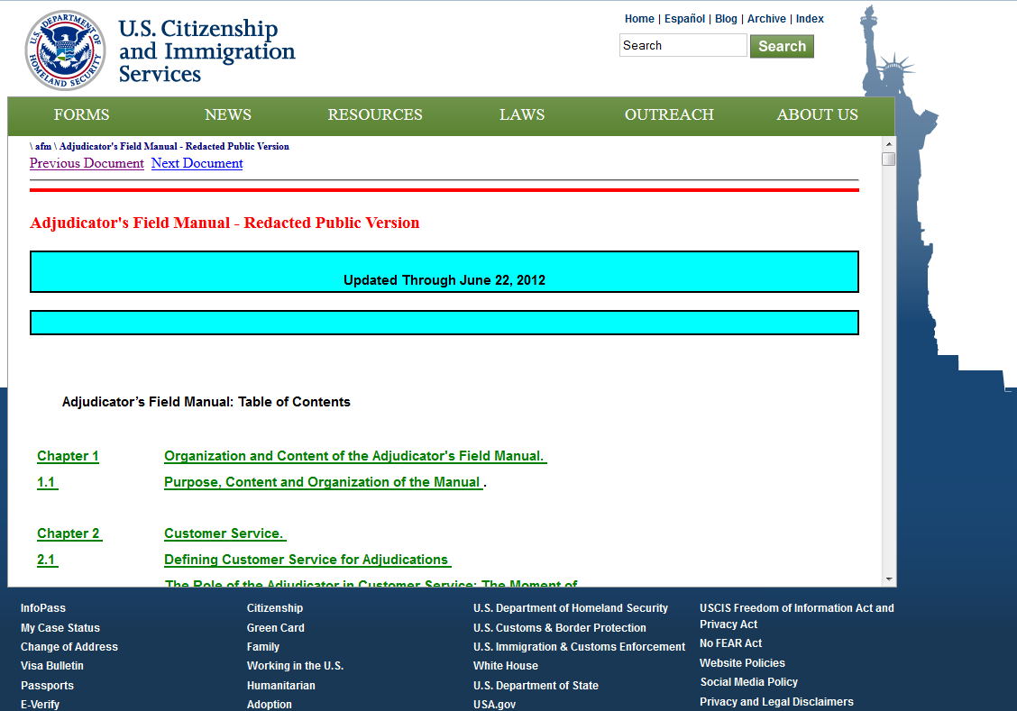
USCIS Adjudicator’s Field Manual
“comprehensively details USCIS policies and procedures for adjudicating applications and petitions”
Notes:
Written for adjudicators to use to process paperwork.
Demo Chapter 2. Says, “you should provide such and such level of service”. This manual is written for the people who will look at the paperwork you file with the USCIS. So, they will apply any rubrics in this manual. Use it to prep your material, and then to see how your paperwork is processed.

Slide 24
US Customs and Border Protection Inspector’s Field Manual
Manual for Customs and Border Protection inspectors. Agency does not maintain a public version.
Released in response to a FOIA request, and slowly getting out of date.
FOIA release: http://www.lexisnexis.com/legalnewsroom/immigration/b/insidenews/archive/2012/02/17/cbp-inspector-s-field-manual-online.aspx
FOIA release with formatting cleaned up: http://shusterman.com/pdf/cbpinspectorsfieldmanual.pdf
Notes:
The image I put isn’t the actual release. This is an edited one.
You can get the actual release by following the link to a PDF here: http://www.lexisnexis.com/legalnewsroom/immigration/b/insidenews/archive/2012/02/17/cbp-inspector-s-field-manual-online.aspx
This edited one is posted at http://shusterman.com/pdf/cbpinspectorsfieldmanual.pdf
USCIS made their Inspector’s Field Manual available on the website, and uses the website to deliver it to staff. US Customs and Border Protection does not. This manual was released as the result of a FOIA request. It is not up-to-date. The PDF dates to 2008.

Slide 25
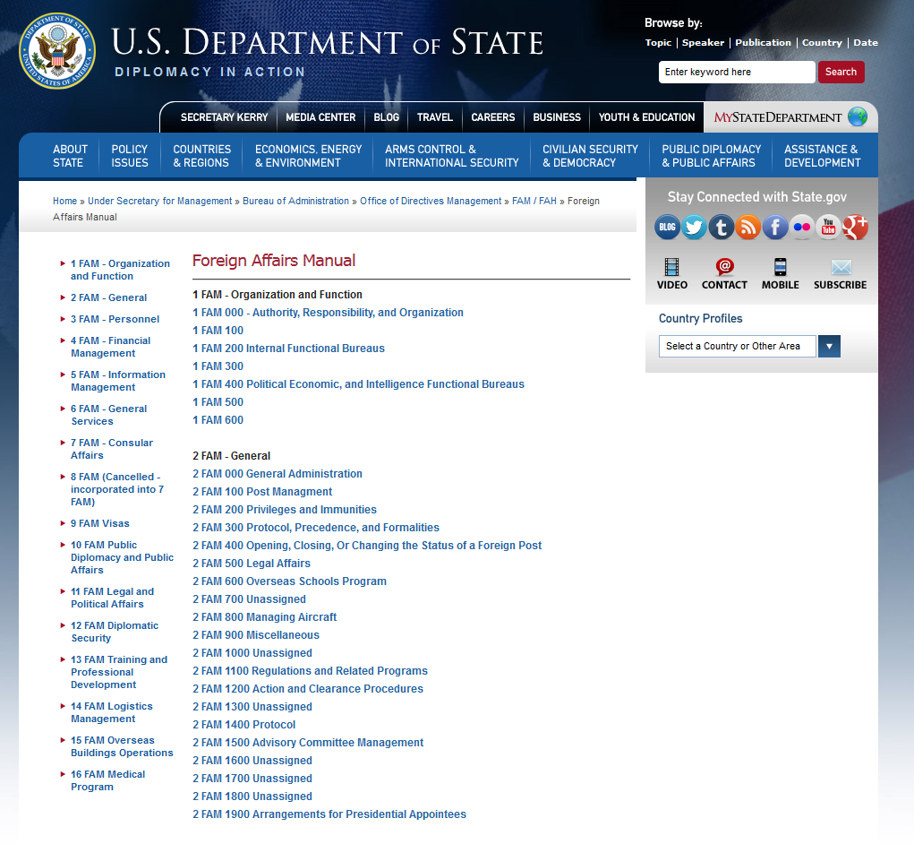
US Dept. of State Foreign Affairs Manual
Notes:
Department of State provides information to people who want to immigrate. It will tell people to file such and such a petition with USCIS. This is it’s procedure manual.

Slide 26
Researching Immigration Law
October 9, 2013
Presented by Wilhelmina Randtke
Electronic Services Librarian
Sarita Kenedy East Law Library
St. Mary’s University School of Law

